Slide 1

Ideas for Output
Synkentrono Software Solutions Private Limited
Authored by : Girish, Ashwini, Shruti

Slide 2
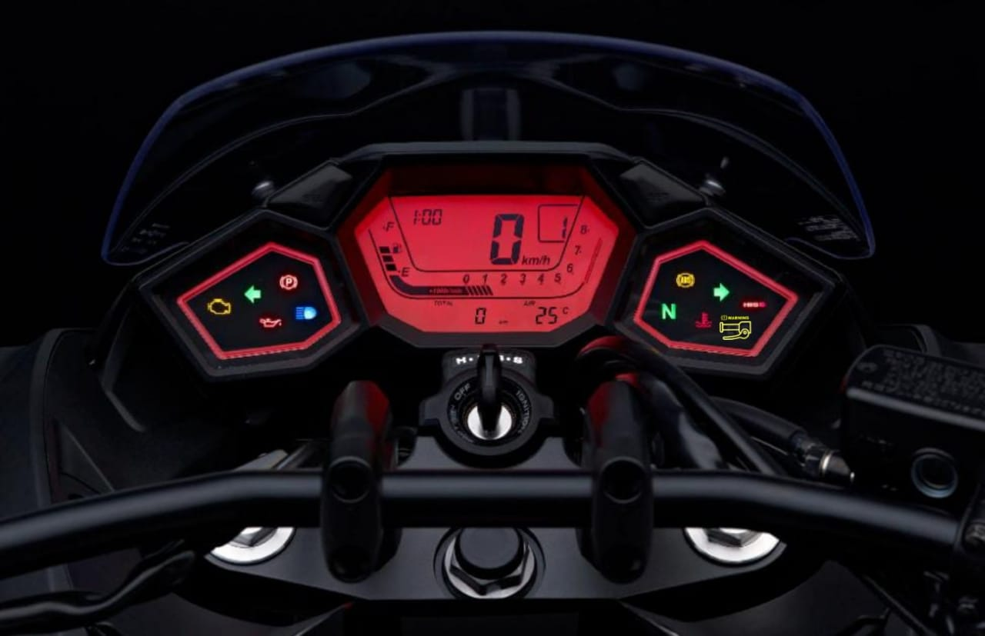
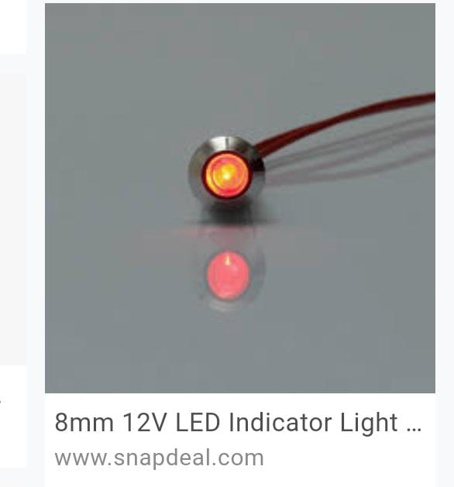

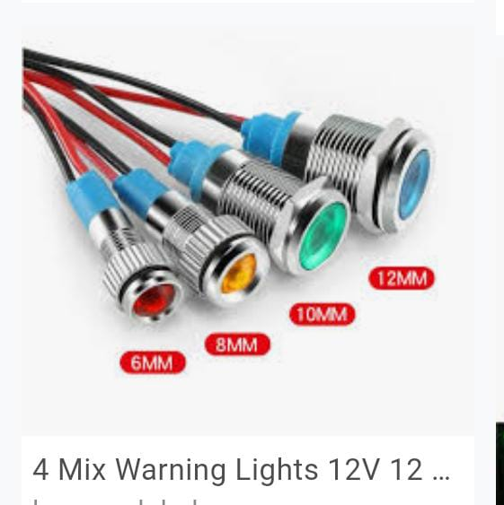
Displaying warning in a dashboard
-First approach
-When release left hand - display any color
-When release right hand- display any color
8mm 12V LED
Symbol to
be used

Slide 3
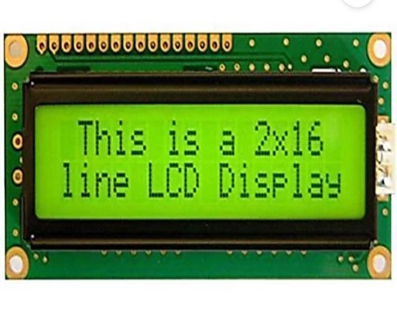
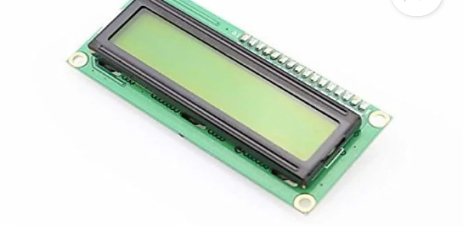
Displaying a message to the rider
- You are in danger
- Warning
- Rash driving alert
Requires TFT LCD display which is
easy to interface with most micro
controllers.
Works with any microcontroller.
contarast of the screen can be
Varied by varying voltage.
Description-
Type: LCD alphanumeric
Color: green backlight
Power: 5V

Slide 4
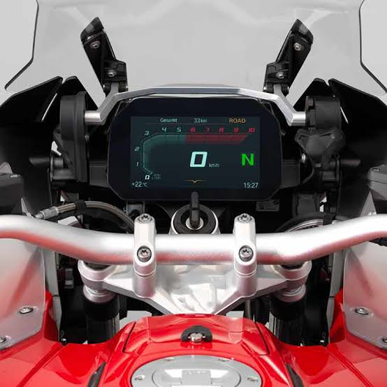
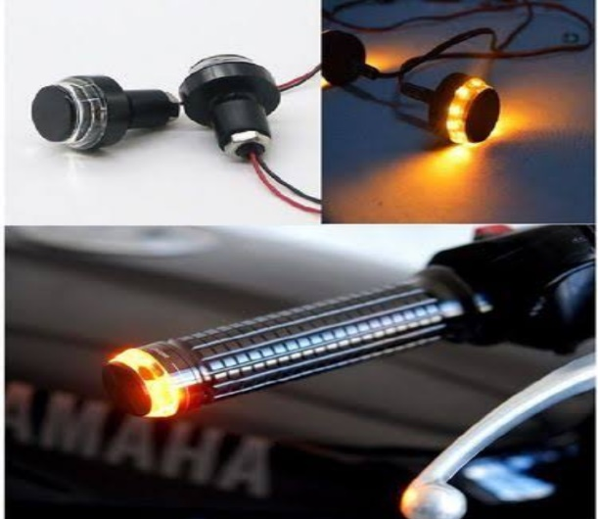
Indication with handlebar light
- Second approach.
It involves lights in handlebars
to indicate when release of
either hands.
Easy installation placement on
handle bar both ends.
Description-
type: LED
colour: white orange power: 12V

Slide 5
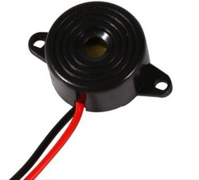
Indicator with beep sound.
Indication with light for 5 seconds when it is sensed either of the hands are not in contact with the handle later on continued indication with
beep.
Buzzer can be used for this purpose.
Description-
Type: automotive
Material: plastic
Power supply: DC

Slide 6
Sending a message to the bike owner and respective traffic department
For above process CDMA or GSM can be used as medium for communication.
In these schemes, the message is modulated on a longer spreading sequence, consisting of several chips.

